Slide 1
Continuous Deployment using Terraform

Slide 2
Agenda
What is Terraform
Terraform Resource
Terraform Providers
Terraform Modules
Terraform Workflow
Terraform State

Slide 3
Overview of Terraform

Slide 4
What is Terraform
A provisioning declarative tool that based on Infrastructure as a Code paradigm
Uses own syntax - HCL (Hashicorp Configuration Language)
Written in Golang.
Helps to evolve you infrastructure, safely and predictably
Applies Graph Theory to IaaC
A plugin-based architecture model
Open source. Backed by Hashicorp company
Terraform is not a configuration management tool

Slide 5

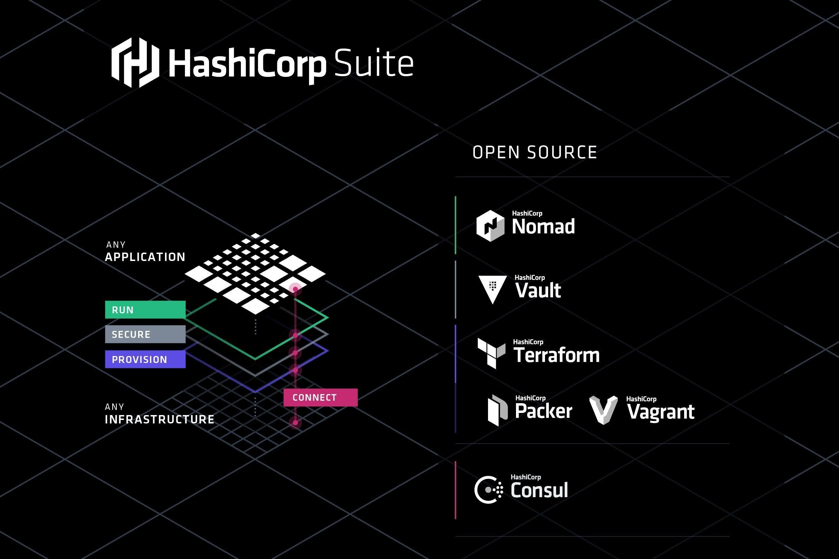

Slide 6
Manage using IaC with Terraform
Visibility
IaC serves as a very clear reference of what resources we created, and what their settings are. We don’t have to navigate to the web console to check the parameters.
Stability
If you accidentally change the wrong setting or delete the wrong resource in the web console you can break things. IaC helps solve this, especially when it is combined with version control, such as Git.
Scalability
With IaC we can write it once and then reuse it many times. This means that one well written template can be used as the basis for multiple services, in multiple regions around the world, making it much easier to horizontally scale.
Security
Once again IaC gives you a unified template for how to deploy our architecture. If we create one well secured architecture we can reuse it multiple times, and know that each deployed version is following the same settings.
Audit
Terraform not only creates resources it also maintains the record of what is created in real world cloud environments using its State files.

Slide 7
Terraform Architecture

Slide 8
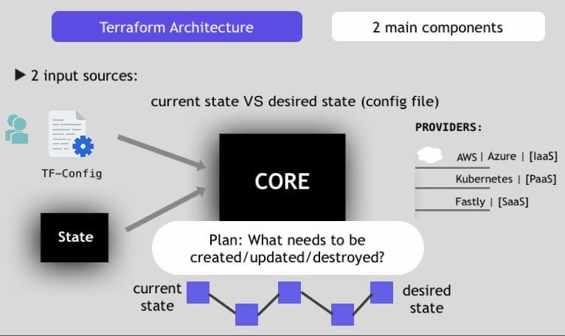

Slide 9
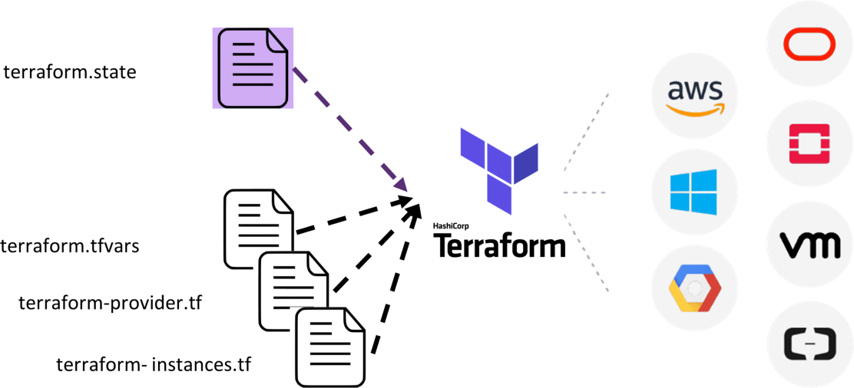

Slide 10
Terraform Providers

Slide 11

Terraform Providers
IaaS, PaaS, and SaaS
Community and HashiCorp
- AWS, Azure, GCP, and Oracle
Open source using APIs
Resources and data sources Multiple instances

Slide 12
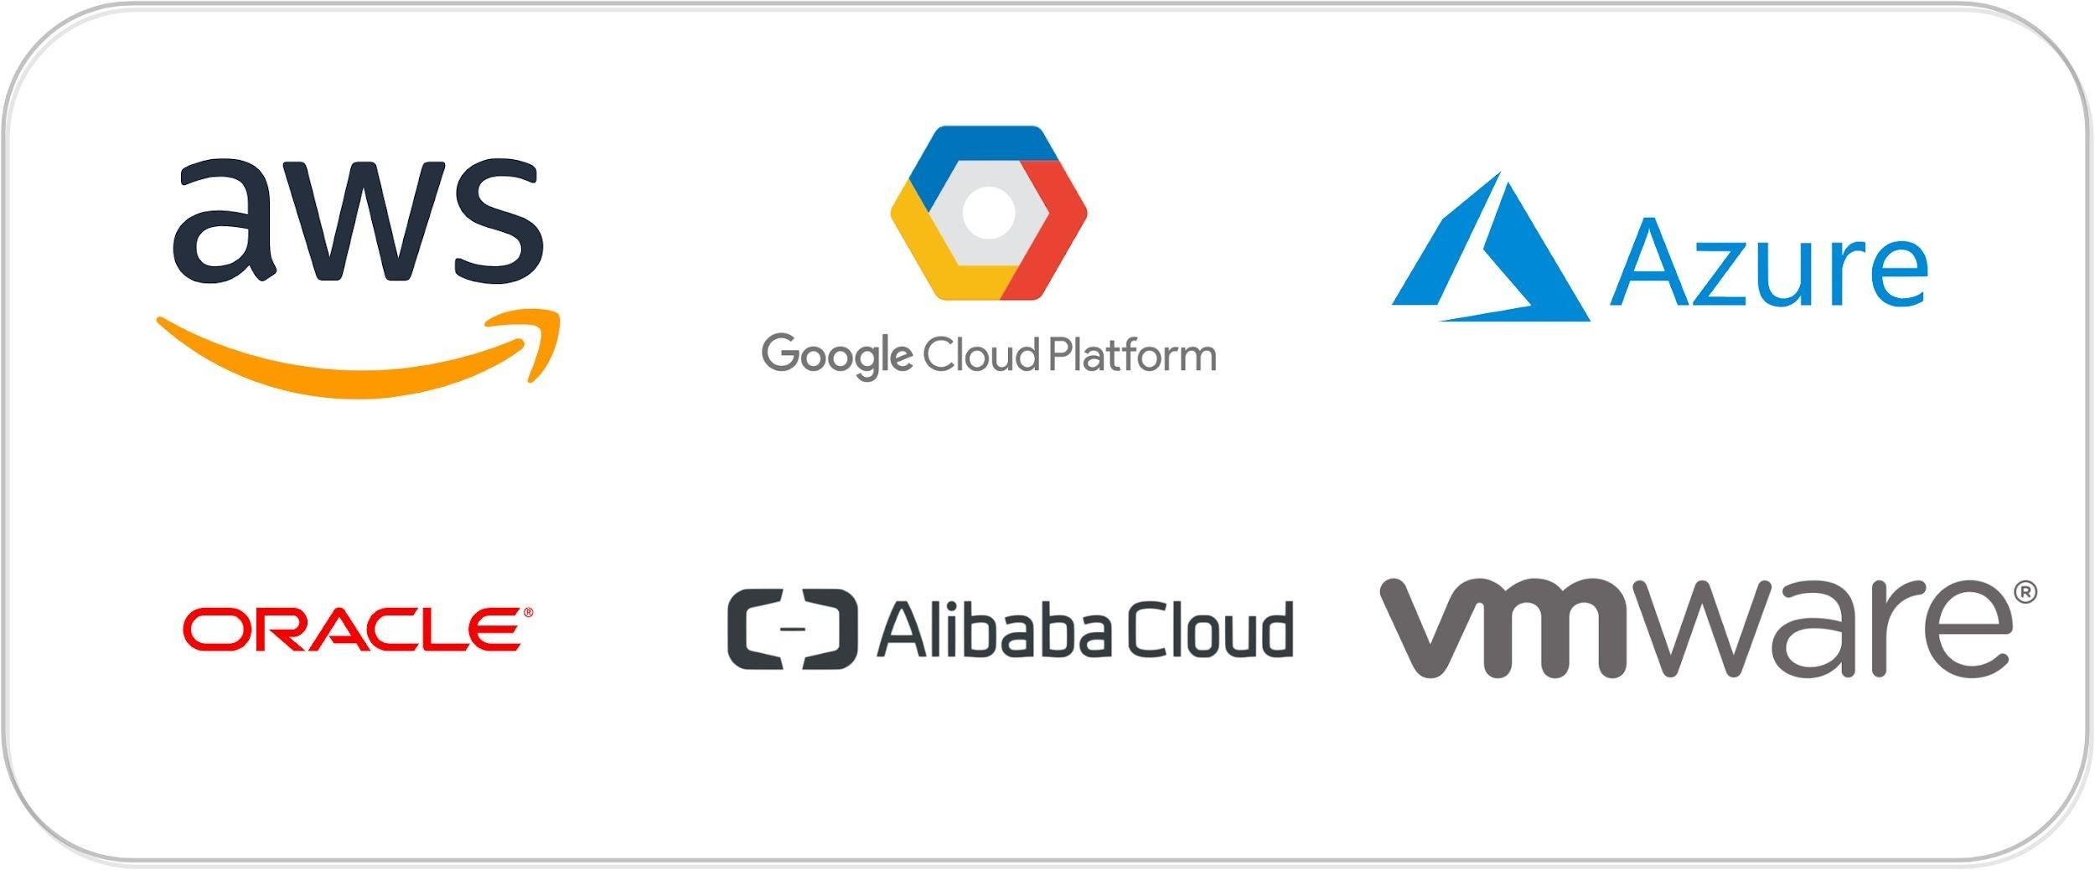
Terraform: Providers (Plugins)
1125+ infrastructure providers
Major Cloud Partners

Slide 13



Terraform: Providers
Can be integrated with any API using providers framework
Note: Terraform Docs → Extending Terraform → Writing Custom Providers
OpenFaaS
OpenAPI
Generic Rest API
Stateful
Docker
Kubernetes
Nomad
Consul
Vault
Terraform :)
GitLab
GitHub
BitBucket
DNS
Palo Alto Networks
F5 BIG-IP
Template
Random
Null
External
(escape hatch)
Archive
NewRelic
Datadog
PagerDuty
Digital Ocean
Fastly
OpenStack
Heroku

Slide 14

Terraform Providers
Providers are HEART of Terraform
Every Resource Type (example: Azure Resource Group), is implemented by a Provider
Without Providers Terraform cannot manage any infrastructure.
Terraform Admin
Providers are distributed separately from Terraform and each provider has its own release cycles and Version Numbers
Terraform Registry is publicly available which contains many Terraform Providers for most major Infra Platforms
Local Desktop
1
terraform init
Terraform CLI
Azure Cloud
Download Provider
Terraform Registry
3
terraform plan
4
terraform apply
Azure
APIs
Terraform Azure
Provider
5
terraform destroy
2
terraform validate
Resource Group

Slide 15
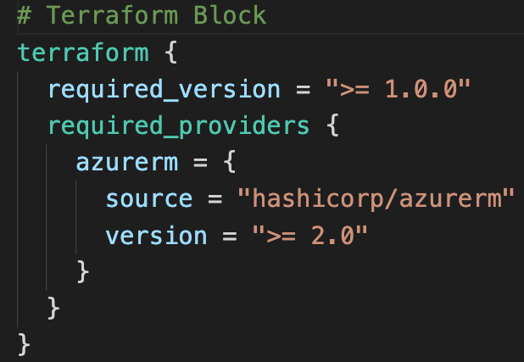
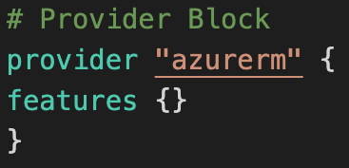
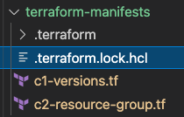
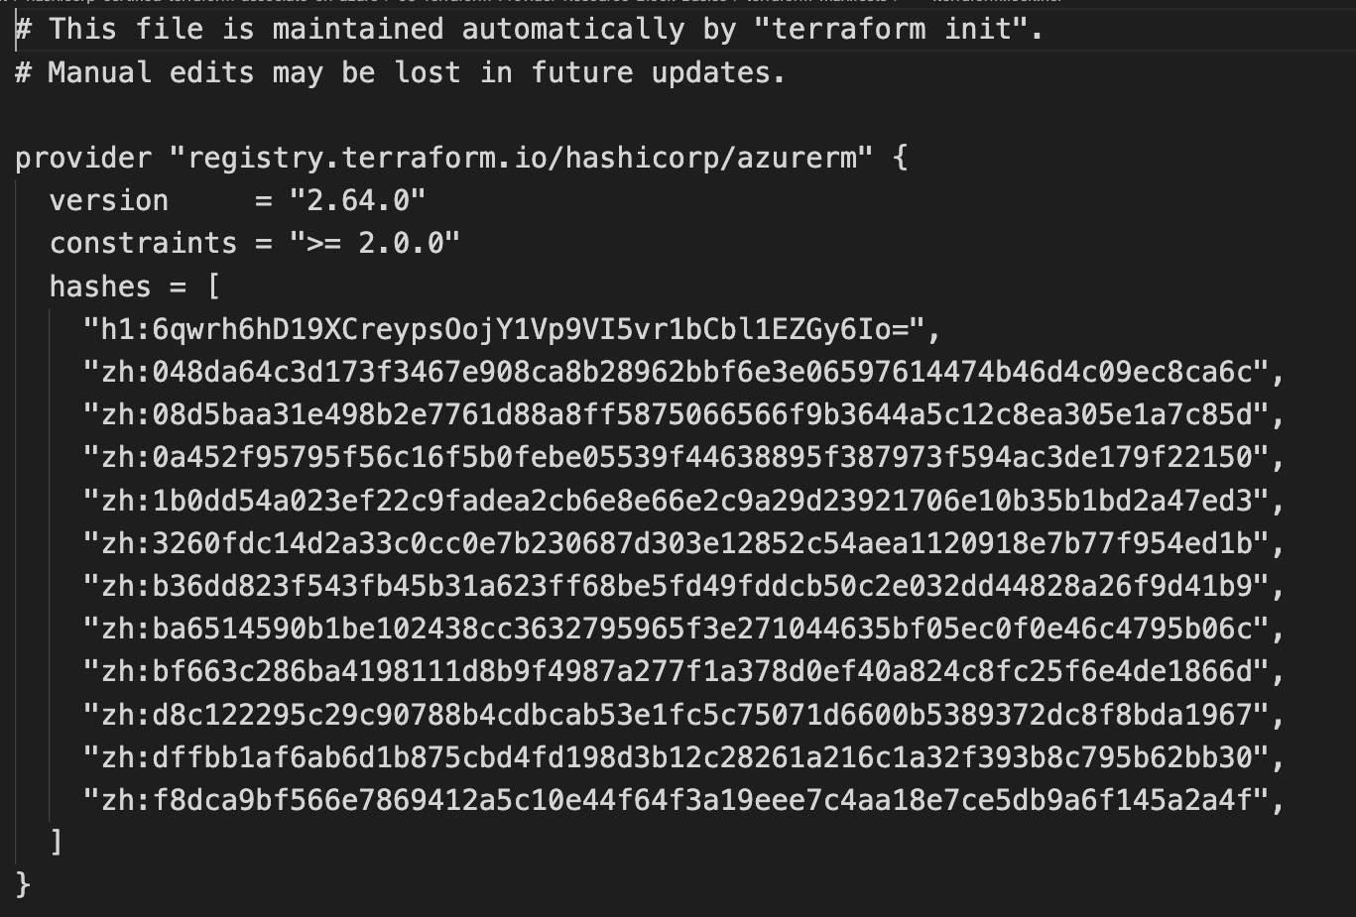
Terraform
Providers
Provider Requirements
Provider Configuration
Dependency Lock File

Slide 16
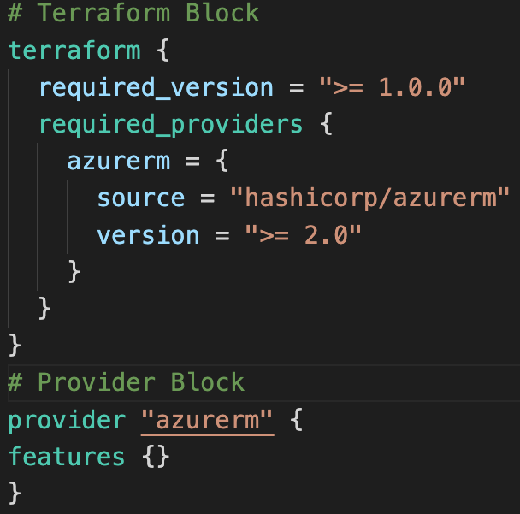
Required Providers
Local Names
Local Names are Module specific and should be unique per-module
Terraform configurations always refer to local name of provider outside required_provider block
Users of a provider can choose any local name for it (myazure, azure1, azure2).
Recommended way of choosing local name is to use preferred local name of that provider (For Azure Provider: hashicorp/azurerm, preferred local name is azurerm)
Source
It is the primary location where we can download the Terraform Provider
Source addresses consist of three parts delimited by slashes (/)
[<HOSTNAME>/]<NAMESPACE>/<TYPE>
registry.terraform.io/hashicorp/azurerm
Registry Name is optional as default is going to be Terraform Public Registry

Slide 17




Terraform Registry
Terraform Provider Registry
Providers
registry.terraform.io
Modules
Provider Badges
These are owned and maintained by HashiCorp
Provider Documentation
These are owned and maintained by third-party technology partners. HashiCorp has verified the authenticity of the Provider’s publisher
Community providers are published to the Terraform Registry by individual maintainers, groups of maintainers, or other members of the Terraform community.
Archived Providers are Official or Verified Providers that are no longer maintained by HashiCorp or the community.

Slide 18
Terraform Workflow

Slide 19
Terraform must store state about your managed infrastructure and configuration
Terraform
Admin
This state is used by Terraform to map real world resources to your configuration (.tf files), keep track of metadata, and to improve performance for large infrastructures.
Local Desktop
This state is stored by default in a local file named "terraform.tfstate", but it can also be stored remotely, which works better in a team environment.
1
Azure Cloud
terraform init
Terraform CLI
Download Provider
Terraform Registry
Virtual Network
Subnet
Public IP
Terraform Azure
Provider
4
terraform apply
Azure
APIs
5
terraform destroy
Resource Group
Network Interface
2
terraform validate
3
terraform plan
The primary purpose of Terraform state is to store bindings between objects in a remote system and resource instances declared in your configuration.
Terraform State
File
terraform.tfstate
When Terraform creates a remote object in response to a change of configuration, it will record the identity of that remote object against a particular resource instance, and then potentially update or delete that object in response to future configuration changes.

Slide 20
Terraform WorkFlow
init
validate
plan
apply
destroy
1
2
3
4
5
terraform init
terraform validate
terraform plan
terraform apply
terraform destroy

Slide 21
Terraform WorkFlow
init
validate
plan
apply
destroy
1
2
3
4
5
Used to Initialize a working directory containing terraform config files
This is the first command that should be run after writing a new Terraform configuration
Downloads Providers
Validates the terraform configurations files in that respective directory to ensure they are syntactically valid and internally consistent.
Creates an execution plan
Terraform performs a refresh and determines what actions are necessary to achieve the desired state specified in configuration files
Used to apply the changes required to reach the desired state of the configuration.
By default, apply scans the current directory for the configuration and applies the changes appropriately.
Used to destroy the Terraform-managed infrastructure
This will ask for confirmation before destroying.

Slide 22
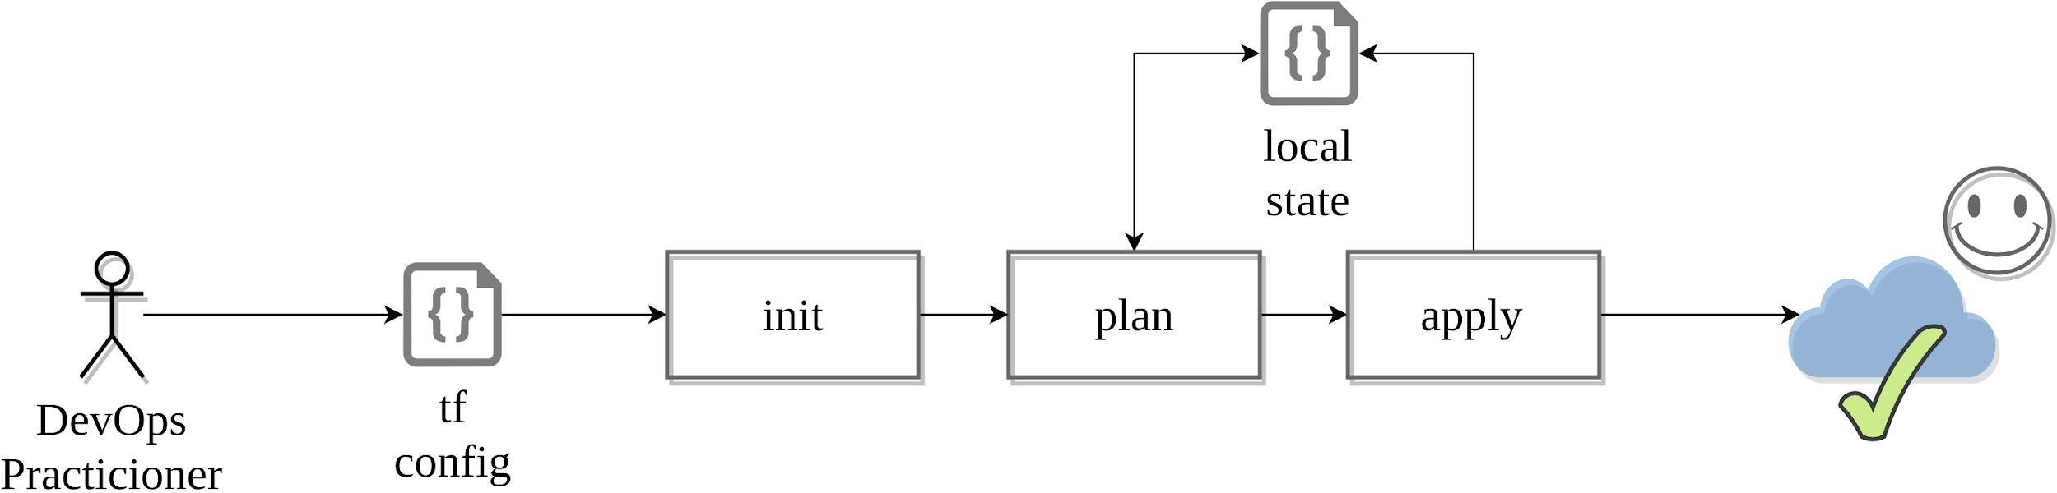
Workflow: Adoption stages
Single contributor

Slide 23
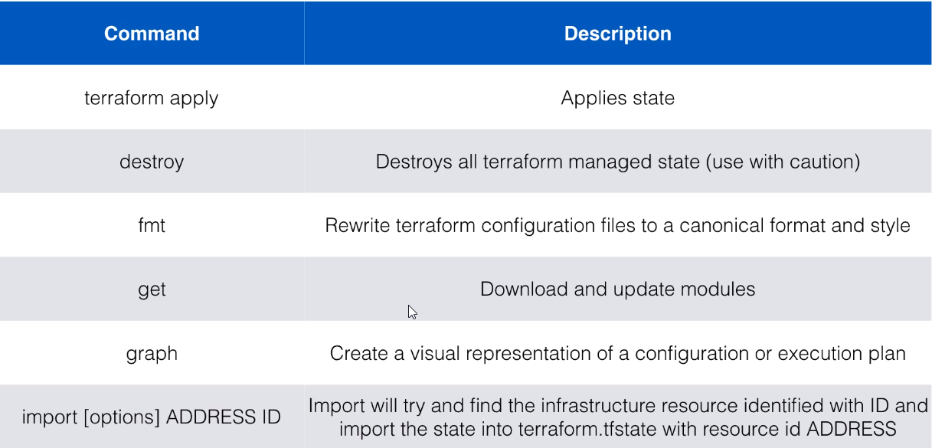
Terraform Commands

Slide 24
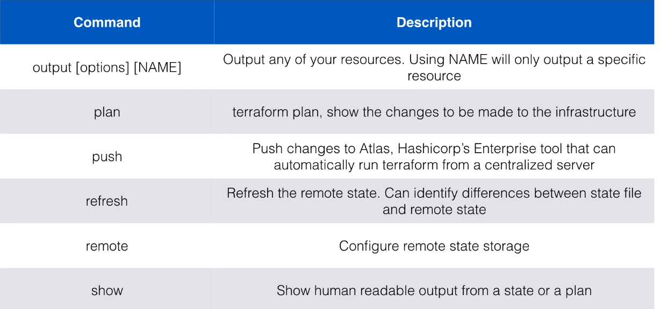
Terraform Commands

Slide 25
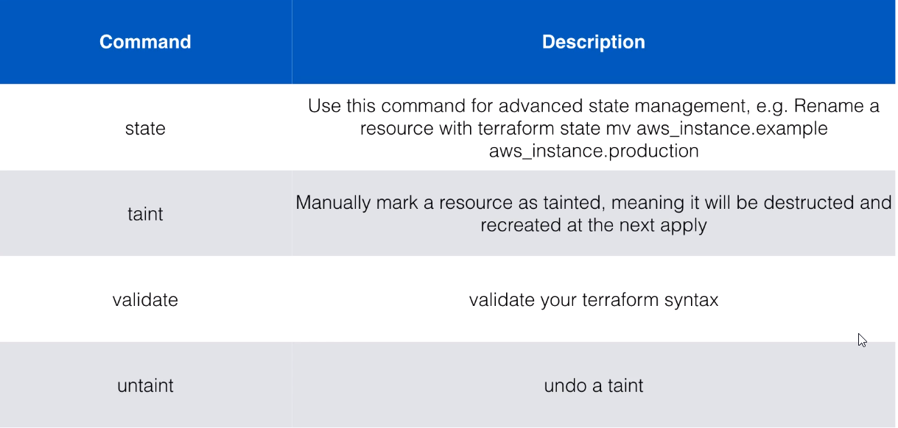
Terraform Commands

Slide 26
Terraform State

Slide 27

Terraform State
JSON format (Do not touch!) Resources mappings and metadata
Locking
Local / remote Environments

Slide 28
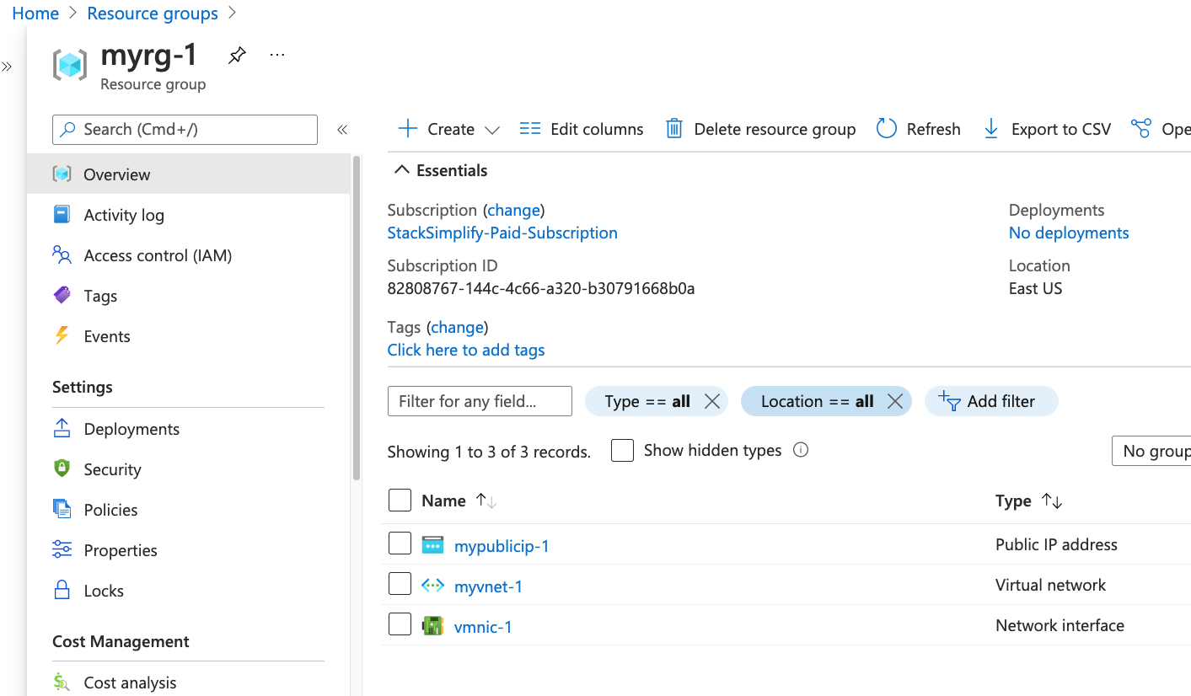

Desired & Current Terraform States
Terraform Configuration Files
Real World Resources
terraform.tfstate
Desired State
Current State

Slide 29
Terraform State
Terraform keeps remote state of the infrastructure
It stores it in a file called terraform.tfstate
There is also a backup of the previous state in terraform.tfstate.backup
When we execute terraform apply, a new terraform.tfstate and backup is written to disk.
If the remote state changes and we hit ‘terraform apply’ again, terraform will make changes to meet the correct remote state again.
For example, if we terminate the instance that is managed by terraform manually. After the next terraform apply, it will start the instance again.

Slide 30
Important Links
https://www.terraform.io/
https://www.terraform.io/use-cases/infrastructure-as-code
https://registry.terraform.io/
https://registry.terraform.io/providers/hashicorp/aws/latest/docs
https://developer.hashicorp.com/terraform/intro/core-workflow
https://developer.hashicorp.com/terraform/tutorials/aws-get-started/aws-build
https://developer.hashicorp.com/terraform/language/state

Slide 31
Thank You

